Slide 1

Computer Vision Workflow: Bottleneck Identification, Logical Analysis, and Visual Representation
Supervised by:
Presented by:
Dr. S. YUVARAJ
SIMATS Engineering
DASARI HARITHA(192425254)
SIMATS Engineering

Slide 2


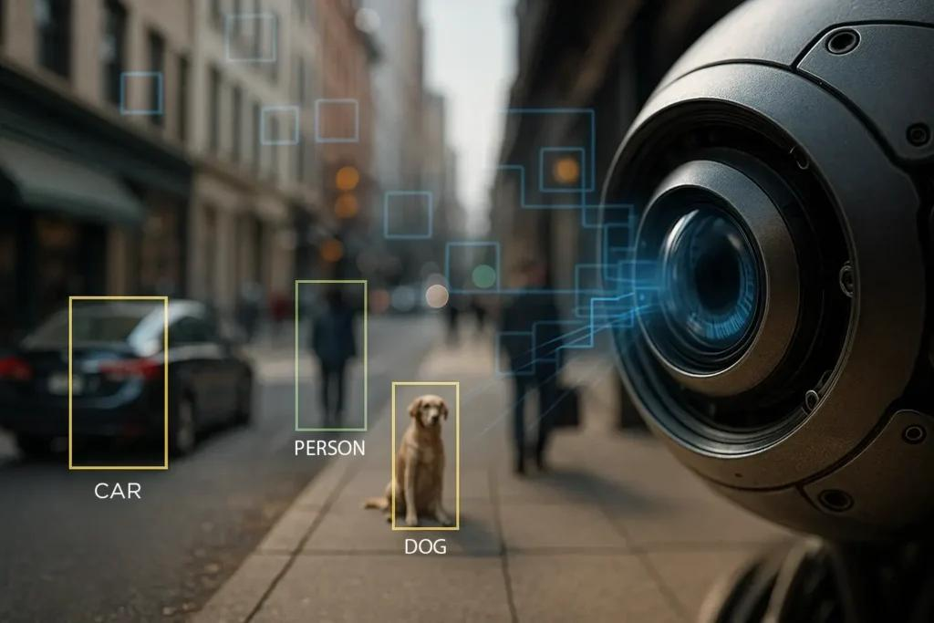
INTRODUCTION TO COMPUTER VISION
DEFINITION
Computer Vision is a branch of Artificial Intelligence (AI) that enables computers to capture, process, analyze, and understand images or videos, allowing them to make intelligent decisions based on visual information.
APPLICATIONS
Face Recognition
Healthcare
Self-Driving Cars
Security Surveillance
Agriculture

Slide 3
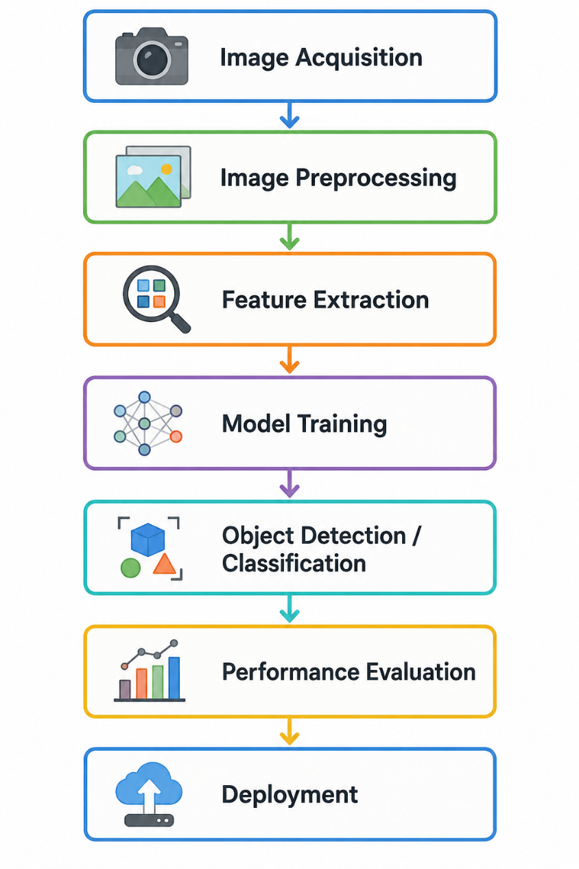
COMPLETE COMPUTER VISION WORKFLOW

Slide 4
BOTTLENECKS & LOGICAL ANALYSIS
Workflow Stage | Bottleneck | Impact
Image Acquisition | Poor-quality Or Blurred Images | Reduces Input Quality
Preprocessing | Noise And Inconsistent Lighting | Affects Feature Extraction
Feature Extraction | Loss Of Important Features | Decreases Model Accuracy
Model Training | Large Datasets And High Computational Cost | Increases Training Time
Prediction | Slow Inference Speed | Delays Real Time Applications
Deployment | Limited Hardware Resources | Reduces System Performance

Slide 5
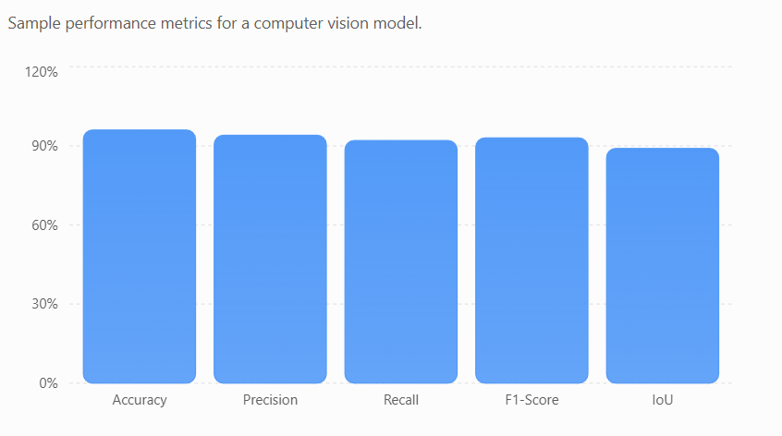
SOLUTIONS & PERFORMANCE EVALUATION
SOLUTIONS
Data Augmentation
Image Enhancement
Transfer Learning
GPU Acceleration
Model Optimization
EVALUATION METRICS
Accuracy
Precision
Recall
F1-Score
IoU

Slide 6
APPLICATIONS & CONCLUSION
APPLICATIONS
Healthcare
Autonomous Vehicles
Smart Surveillance
Manufacturing
Agriculture
Robotics
CONCLUSION
Efficient workflow improves accuracy.
Identifying bottlenecks enhances performance.
Computer Vision enables intelligent automation.

Slide 7
THANK YOU!

